Slide 1
Alpha maps
Tom Kirby
Brett Kights
James Hall
Niall Mellers
Matthew Housely

Slide 2
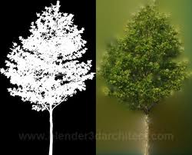
What are Alpha maps?
“Alpha mapping is a process by which a texture is applied to an object in three-dimensional (3D) Computer-Generated Imagery (CGI) that creates transparency. The term “opacity” is often used in computer graphics, and full opacity means that an object is solid, while no opacity indicates a transparent object. Alpha mapping is the creation of a texture map for an object that does not provide color or texture, but instead indicates varying levels of opacity for it.” - http://www.wisegeek.com/what-is-alpha-mapping.htm

Slide 3
Why Alpha maps are used?
“Alpha mapping is important for the creation of realistic computer graphics that are not overly intensive for rendering or display. If an artist wants to create a hole in the box (in a box mesh) then doing so would require a change in the number of polygons to create the shape of the hole in one of the sides. The use of alpha mapping, however, allows an artist to simply create a map with a black area for the hole, which becomes transparent in the final image” - http://www.wisegeek.com/what-is-alpha-mapping.htm

Slide 4
How an alpha map is created
“Different types of images can be used during alpha mapping, though the image used is typically a simple grayscale graphic. This means that it does not contain any colour, but instead consists only of black, white, and shades of grey. The image created in this way is referred to as an “alpha map. Once the map is applied to an object, then parts of it that are white in the alpha map appear as normal, while parts that are black become completely transparent. Different shades of gray can be used in alpha mapping to indicate varying degrees of opacity. Tones closer to white are more solid, while those toward black are more transparent. This does not actually change the mesh itself, only its appearance.” - http://www.wisegeek.com/what-is-alpha-mapping.htm

Slide 5
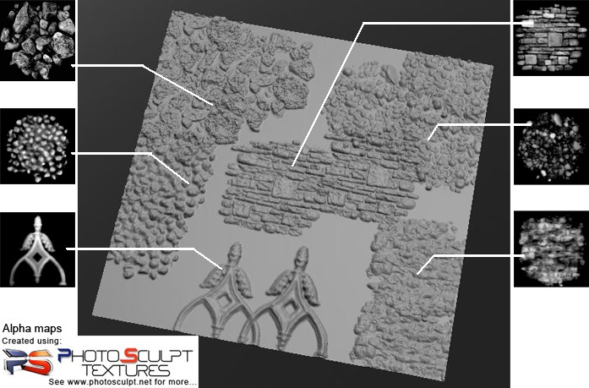
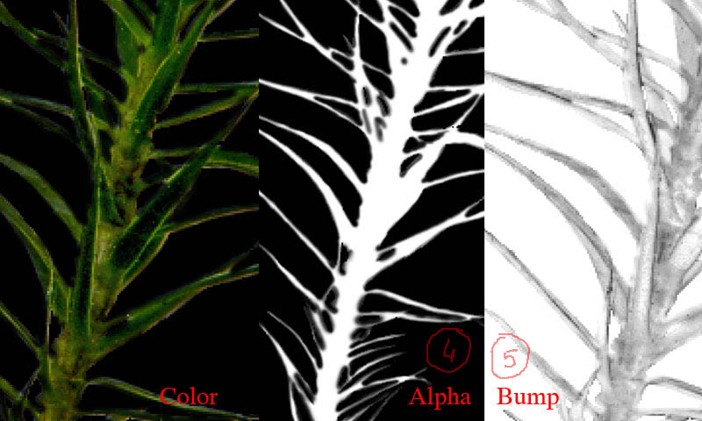
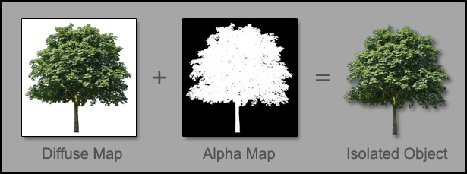
Examples of alpha maps

Slide 6
Sources
www.cornucopia3d.com
www.3drender.co.uk
www.photosculpt.net
http://www.photosculpt.net/dump/2010/11/6/tutorial-12-how-to-create-an-alpha-map-for-sculpting-in-zbru.html
http://www.wisegeek.com/what-is-alpha-mapping.htm

